Slide 1
Literature Review
American Data

Slide 2
18 A genetic algorithm approach to detecting temporal patterns indicative of financial statement fraud, 2007
51/339
AAER(2002.3-2004.3, violate 10b-5, improper revenue recognition)
Genetic algorithm

Slide 3
20 Making words work: using financial text as a predictor of financial events, 2010
61/61
AAER
Text mining (+ SVM)
WordNet

Slide 4
21 Can linguistic predictors detect fraudulent financial filings? , 2010
126/622
1993-2006(four sources, 10b-5), 10-Ks from EDGAR
6 periods from -4 to +1, three types :pre, adv, post
Text mining
Natural Language Processing tools
Bag of words
Naïve Bayes classifier
SVM

Slide 5
22 Accounting variables, deception, and a bag of words: assessing the tools of fraud detection, 2015
1407/4708
Source date: 1999.10~2009.3(AAER-1190~2762, key word searching, 10-Q&10-K, MD&A section)
Fraudulent date: 1994-2006
Text mining
Bags of words
(Random forest, F-scores)

Slide 6
30 Financial fraud detection using vocal, linguistic and financial cues, 2010
41/1531
Audio file
Audio + text mining

Slide 7
34 Predicting material accounting misstatements, 2011
293/79358
AAER-1~2261(GAAP), 10-Q&10-K
Logistic regression
F-score

Slide 8
35 Identification of fraudulent financial statements using linguistic credibility analysis, 2011
101/101
AAER(MD&A)
Text mining + C4.5
Text mining + Naïve Bayes
Text mining + SVM
Affect, complexity, diversity, expressivity, nonimmediacy, quantity, specificity, uncertainty

Slide 9
36 Do sentiments matter in fraud detection? Estimating semantic orientation of annual reports, 2016
180/180
Several sources(MD&A, 10b-5)
Fraudulent date: 1994-2012
Text mining(sentiment features extracted by DICTION, LIWC)

Slide 10
41 Financial statement fraud detection: an analysis of statistical and machine learning algorithms, 2011
51/15934
SVM
Logistic regression
C4.5
Bagging
Multilayer perceptron
Full text is not available, abstract is saved

Slide 11
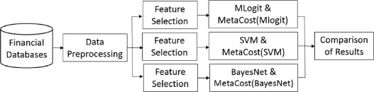
42 Detecting financial misstatements with fraud intention using multi-class cost-sensitive learning, 2016
788/2156
Fraudulent date: 1992-2005(source not mentioned)
Logistic regression, SVM, Bayesian belief network
Feature referred to previous literatures

Slide 12
43 How to protect investors? A GA-based DWD approach for financial statement fraud detection, 2014
12/45
2007(AAER)
Distance weighted discrimination
SVM
C4.5
Multilayer perceptron
(Financial features/ textual features)

Slide 13
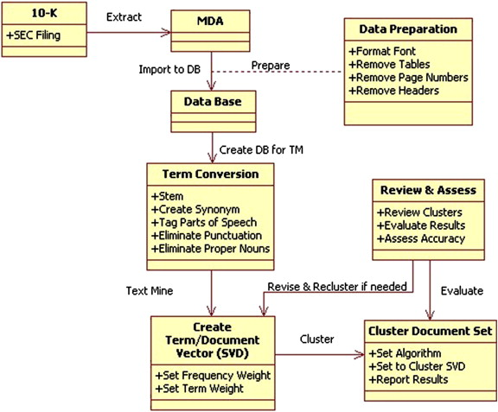
82 A computational model for financial reporting fraud detection, 2011
100/0
AAER(2006-2008, MD&A)
Text mining

